Slide 1
SVNT TAP

Slide 2
Scope
A youtube enthusiast can survey how trending his video / idea can become given the trends and analysis of youtube in the US.

Slide 3
User Story
1 User Story
User provides some inputs including: youtube user-name,
title of upcoming video, category of content, comments, tags and ratings.
Application predicts possible views and suggest recommendations if any.

Slide 4
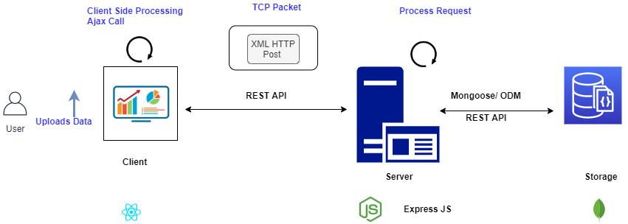
Approach

Slide 5
Tasks and Priority
Design for front end application. high
Front End Application.
Connecting Front End to Data Analysis Service with API Infrastructure. high
Maintaining user session, recording user activity. high
Authentication and Security.
Data Analytics Prediction Service high

Slide 6
Limitations and Future Enhancement
Time Based- A user might use the service obtain high views from the model, however by the time he uploads his video say in a weeks time, trends would have shifted.
Biased Data- A user with high subscribers will always have high views for the first 1 or 2 days doesn't mean the video is trending.
Loosely Coupled Services- Aim to make the Node server independent of Express JS components so that in future MongoDB can be replaced with a different one.
Authentication and Security
Notes:
Maintain user session

